Slide 1









Global AD Transformation

Slide 2
Agenda
Legacy AD Objects Overall Snapshot
AD Migration Approach
Server
User
WS
Next Steps/Timelines

Slide 3
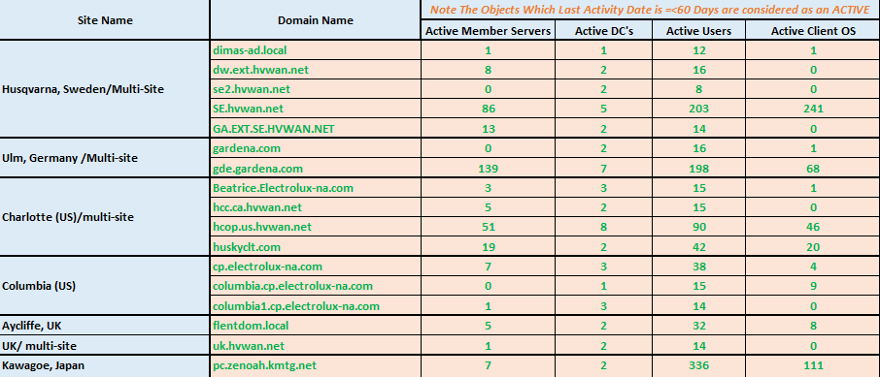
Legacy AD Objects – Overall Snapshot

Slide 4
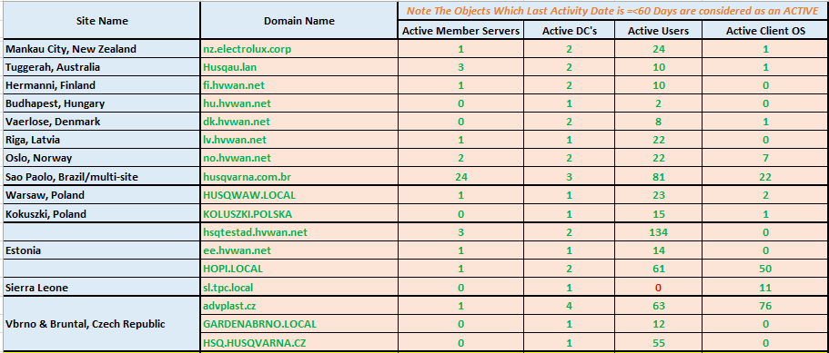
Legacy AD Objects – Overall Snapshot

Slide 5
Legacy AD Objects – Server Migration Approach
Create MAP report for each domain
Segregate into Application and Infra Servers
Application Server Migration Dates including downtime to be confirmed/Arranged by Site Spoc/Application Owner
Infra Server Classification
DHCP servers to be migrated by HCL based on downtime agreed with business
DNS/AD servers to be migrated last
File Server downtime/migration date confirmation to be provided by Site spoc/Application owner due to application dependency on FS (mapped to shares, etc)

Slide 6
Legacy AD Objects – User/WS Migration Approach
Create MAP report for each domain
Utilise the checklist created for Japan

Slide 7
Next steps
Workgroup Servers addition to Global domain – change in scope
Identification of application spocs for some domains (Ex: Baltic) resulting in delay in migration date identification
Prioritising geographies (Europe/APAC first followed by Americas)
Finalisation of migration timelines prior to 23 Aug

